Slide 1

POTATO DISEASE CLASSIFICATION
USING
CONVOLUTIONAL NEURAL NETWORK
Presented by,
MATHI T
RegNo: 513121104020
THANTHAI PERIYAR GOVERNMENT INSTITUTE OF TECHNOLOGY,
VELLORE.

Slide 2

Agenda
Problem Statement
Proposed System/Solution
System Development Approach
Algorithm & Deployment
Result
Conclusion
References

Slide 3
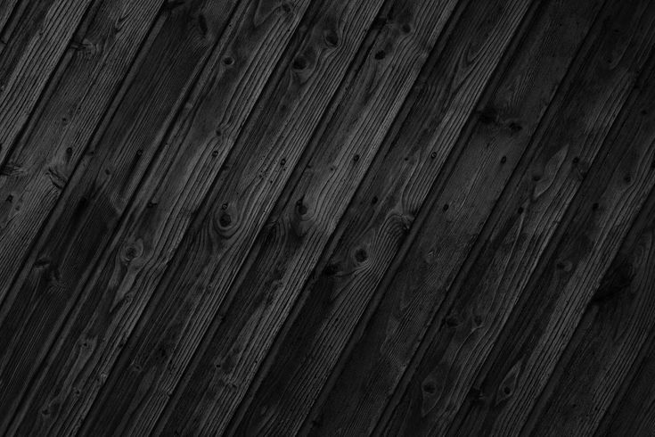
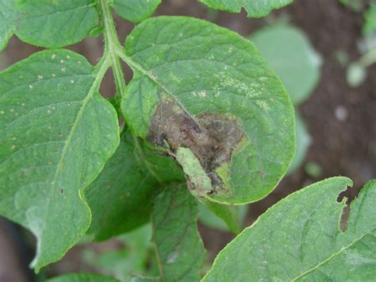
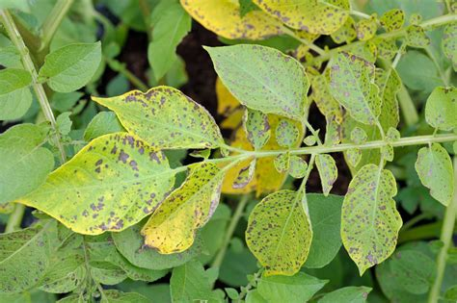
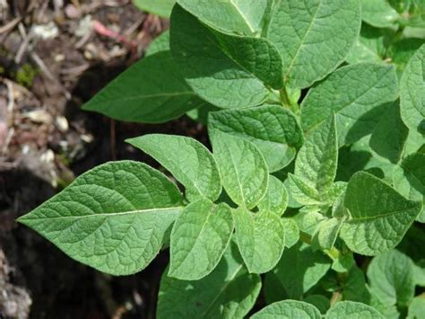
Problem Statement
The aim is to create a Convolutional Neural Network (CNN) model capable of accurately classifying diseases in potato plants through analysis of leaf or stem images. This model will contribute to early detection and effective management of potato diseases, thereby enhancing agricultural productivity and ensuring food security. By leveraging machine learning techniques, the goal is to provide farmers with a reliable tool for timely intervention, ultimately reducing crop losses and improving overall yield and quality of potato crops.
Late blight leaves Early blight leaves Healthy leaves

Slide 4
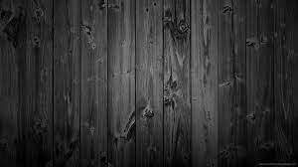
Proposed solution
Utilizing Convolutional Neural Networks (CNNs), we intend to develop a robust model for potato disease classification. The solution involves several key steps:
Data Collection: We will gather a diverse dataset comprising labeled images of healthy potato plants and those affected by various diseases. This dataset will encompass different disease stages, environmental conditions, and potato varieties to ensure model generalization.
Preprocessing: The collected images will undergo preprocessing steps such as resizing, normalization, and augmentation to enhance the quality and diversity of the dataset. This step aims to improve the model's ability to learn relevant features from the input images.

Slide 5
Training: The CNN model will be trained on the preprocessed dataset using appropriate optimization algorithms and loss functions. Hyperparameter tuning will be conducted to optimize model performance in terms of accuracy and efficiency.
Evaluation: The trained model will be evaluated using metrics such as accuracy, precision, recall, and F1-score on a separate validation dataset. Cross-validation techniques may be employed to assess the model's generalization across different datasets.
Deployment: Upon successful evaluation, the trained model will be deployed as a user-friendly application or integrated into existing agricultural systems. This deployment will enable farmers to upload images of potato plants and receive real-time disease classification results, facilitating timely interventions and crop management decisions.

Slide 6
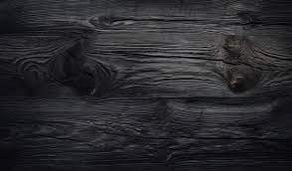
System approach
Software Requirements:
Python: Programming language for developing the machine learning model and application.
Deep Learning Frameworks: Such as TensorFlow, PyTorch, or Keras for building and training the Convolutional Neural Network (CNN) model.
Image Processing Libraries: PIL (Python Imaging Library), or scikit-image for image preprocessing tasks.
IDE (Integrated Development Environment): Such as PyCharm, Jupyter Notebook, or Visual Studio Code or google colab for coding and development.

Slide 7
Hardware Requirements:
GPU (Graphics Processing Unit): Optional but highly recommended for faster model training. NVIDIA GPUs, such as GeForce or Tesla series, are commonly used for deep learning tasks.
CPU (Central Processing Unit): A multi-core CPU with sufficient processing power for data preprocessing, model training, and inference.
Memory (RAM): At least 8GB of RAM is recommended for handling large datasets and training deep learning models.
Storage: Sufficient disk space for storing datasets, model checkpoints, and application files. SSD (Solid State Drive) is preferred for faster data access.
Internet Connection: Required for downloading libraries, datasets, and updates, as well as for deploying web-based applications.

Slide 8

Algorithm & Deployment
The algorithm for potato disease classification using Convolutional Neural Networks (CNNs) involves the following steps:
Data Collection: Gather a dataset of labeled images containing healthy potato plants and those affected by various diseases
Data Preprocessing: Clean and preprocess the images by resizing, normalization, and augmentation to improve the dataset's quality and diversity.
Model Architecture Design: Design a CNN architecture suitable for image classification tasks, comprising convolutional, pooling, and fully connected layers.
Training: Train the CNN model using the preprocessed dataset. Employ techniques such as transfer learning and fine-tuning to leverage pre-trained models and improve training efficiency.

Slide 9
Building the Model:
Creating a Layer for Resizing and Normalization:
Before we feed our images to network, we should be resizing it to the desired size. Moreover, to improve model performance, we should normalize the image pixel value (keeping them in range 0 and 1 by dividing by 256). This should happen while training as well as inference. Hence we can add that as a layer in our Sequential Model.
While resizing the image from (256,256) to (256,256) is not strictly necessary, it will be useful for prediction scenarios where the input image may not be of the expected size.
Plantvillage dataset used. It’s consist of three classes(Early blight,late blight,healthy leaves)
Data augmentation
Compiling the model
Run prediction on a sample image

Slide 10
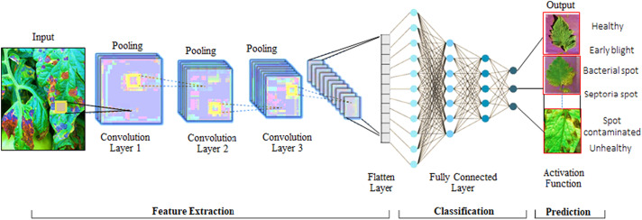

Slide 11

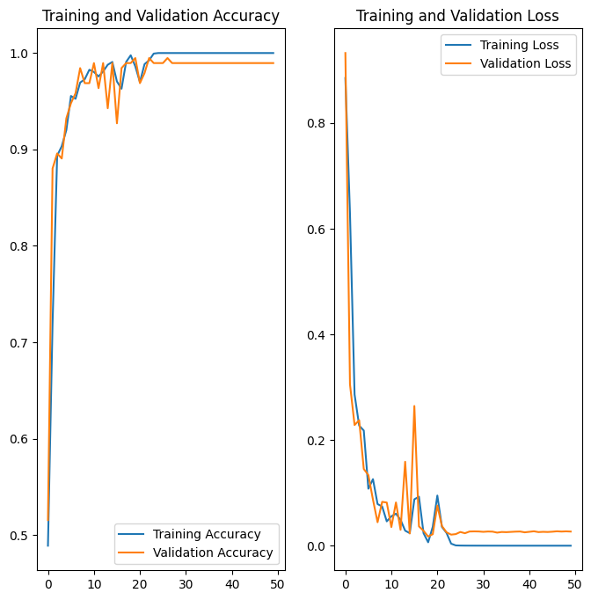
Result

Slide 12
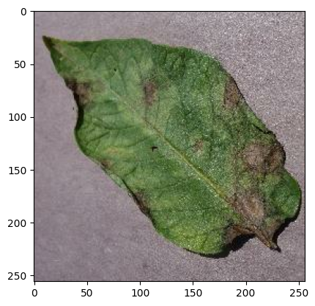
Result(cont...)
first image to predict actual label: Potato___Late_blight
1/1 [==============================] - 0s 131ms/step predicted label: Potato___Late_blight

Slide 13

Conclusion
In conclusion, the development of a Convolutional Neural Network (CNN) model for potato disease classification presents a promising solution for addressing the challenges faced by farmers in managing crop health. By leveraging deep learning techniques, we can create a robust system capable of accurately identifying various diseases affecting potato plants based on images of their leaves or stems. This system offers several benefits, including early disease detection, timely intervention, and improved agricultural productivity. However, successful implementation requires careful consideration of software and hardware requirements, as well as systematic approaches to data collection, preprocessing, model development, training, evaluation, and deployment. Overall, the proposed solution has the potential to revolutionize agricultural practices, contributing to enhanced crop yields, food security, and sustainable farming practices.

Slide 14

References
https://www.tensorflow.org/
https://keras.io/
https://numpy.org/
https://matplotlib.org/
https://www.kaggle.com/datasets/emmarex/plantdisease

Slide 15

Thank you

